Slide 1
Techno Feasibility analysis for metro connectivity Between Faridabad and Gurgaon
Dipin, Abhishek and Payal

Slide 2
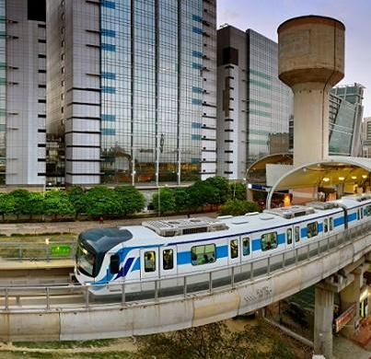
Purpose of
the Study
SIMPLE
PORTFOLIO
PRESENTATION
This study is a feasibility study concerning the plan to develop the HMRTC between Gurugram and Faridabad based on the above-mentioned report.
Main items covered in the study are as follows:
Cost estimation & details.
Economic Analysis
Financial analysis.
Environmental analysis
Technical analysis
Legal systems/standards related to Humans resource.

Slide 3
INTRODUCTION
DMRC submitted Traffic & Transportation report consisting of traffic survey data, its analysis and estimation of ridership.
Sectional and station roads done on 04.07.2016.
DMRC made a presentation on transportation report at Chandigarh on 17.11.2016.
In the meeting, it was felt that initially only a quick connection between Bata Chowk and Gurgaon at Sector-45 may be of more utility.
Its extension may be thought of beyond Neharpar from Bata Chowk to connect to new Faridabad area.

Slide 4
PROJECT COST
Total Estimated Capital Cost Without Taxes & Duties(at JAN 2017 price): With 10 Trains
Without Land Cost : Rs. 3777 Cr.
With land Cost : Rs. 4323 Cr.
Taxes & Duties : Rs. 822 Cr.
Completed Cost : Rs. 5900 Cr.

Slide 5
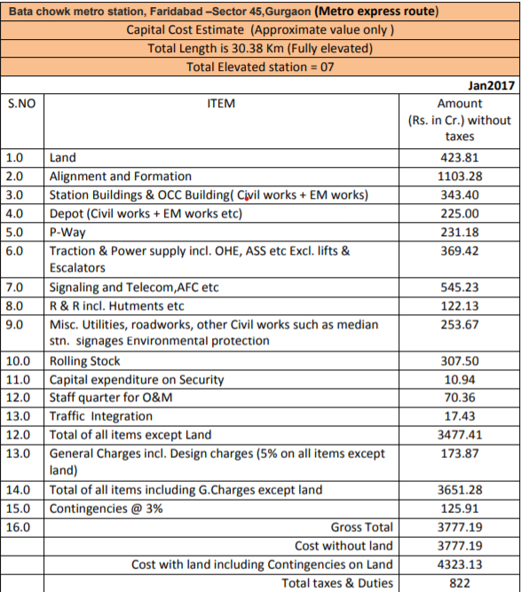
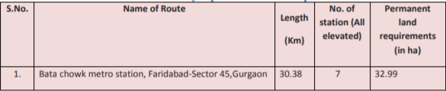
CAPITAL COST ESTIMATION OF THE PROJECT
CAPITAL COST ESTIMATES:
The overall Capital Cost for the proposed alignments for Express Metro Rail corridor estimated at Jan 2017 price level, based on the above considerations without taxes and duties works out to be Rs 4323 crores.
Taxes & Duties such as Customs Duty (CD), Excise Duty (ED), Sales Tax (ST), Works Tax (WT), VAT, etc, have been worked out Rs. 822 Crores.

Slide 6

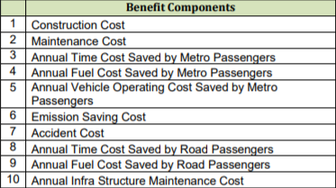
ECONOMIC ANALYSIS
Economic appraisal of a project starts from quantification of measurable economic benefits in economic money values, which are basically the savings of resource cost due to introduction of the metro line.
Economic savings are derived from the difference of the cost of the same benefit components under ‘with’ and ‘without’ metro line

Slide 7
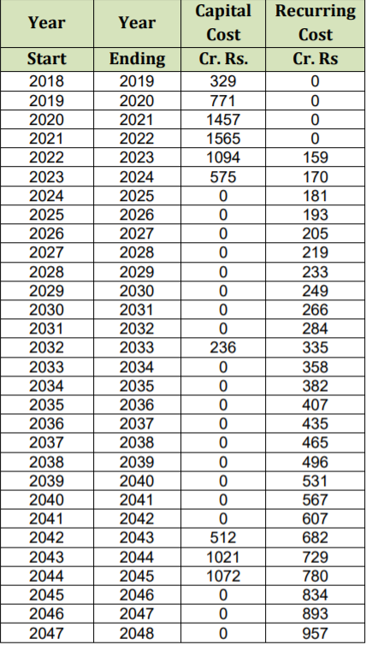
METRO CONSTRUCTION COST/ RECURRING COST
Total actual cost of metro construction (Capital Cost) is derived for the year of estimation (2016) after considering cost of all major component such as Relocation and Rehabilitation(RR), Civil construction for underground and elevated portions, Stations and Depots, Track laying, Signaling and Telecommunication, Power traction line, Rolling stock, Man power etc. On this cost, 5% escalation factor per year (from 2017) is applied to arrive at the Completion Cost as this expenditure is spread over next 8 years.
Recurring Cost includes energy cost, maintenance cost, and operation cost. Economic analysis period is taken from 2018-19 to 2047-48 out of which 4 years (2018-2021) are construction years and next 2 years payment will continue although operation will start in 2021-2022. Additional capital expenditure may be incurred in the years 2031-32 (Rs. 236 Cr.), and in 2041-42 (Rs. 512 Cr.) for purchase of more rolling stock. Replacement cost is also envisaged in 2041-43 (Rs. 2093 Cr). This cost stream is generated with all taxes.

Slide 8

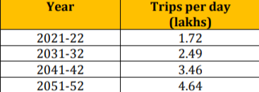
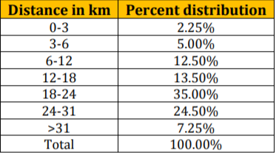
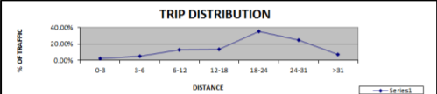
Financial Analysis
The projected ridership figures years are as indicated in table
The growth rate for traffic is assumed at 3.75% Per Annum up to 2031-32, @ 3.35% per annum up to 2041-42 and thereafter @ 3.00% per annum.
Traffic
Cost
Investment cost
Operation and Management Cost
Depreciation cost
Replacement cost
Revenue
Parking
Fare Box
Ad generation
Trip Distribution
Notes:
Investment Cost
For the purpose of calculating the Financial Internal Rate of Return (FIRR), the completion cost with land and central taxes has been calculated by taking escalation factor @ 5% PA. The taxes and duties consist of Custom Duty (CD), Excise Duty (ED), Service Tax (ST) and State Value Added Tax (VAT). The Metro corridor from Faridabad to Gurgaon Sector 45 is eligible for availing concessional project import duty under chapter 98.01 of the Custom Tariff Act.
Operation and Management Cost
The requirement of staff has been assumed @ 30 persons per kilometer. The escalation factor used for staff costs is 9% per annum to provide for both escalation and growth in salaries.
The cost of other expenses is based on the actual O & M unit cost for the Delhi Metro Phase-II project. The average rate of electricity being paid by Delhi Metro for its Phase-I and Phase-II operations in Delhi as at present is Rs. 7.16 per unit, the same has been used for all calculations.
Depreciation
Although depreciation does not enter the FIRR calculation (not being a cash outflow) unless a specific depreciation reserve fund has been provided, in the present calculation, depreciation calculations are placed for purpose of record.

Slide 9
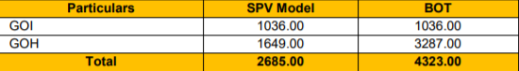
Alternative model of Financing
SPV MODEL
BOT MODEL
The FIRR for a period of 30 years period including construction with central taxes and land cost is positive i.e. 4.16%. Considering the positive FIRR as well as social considerations of requirement of reliable public transport, it is recommended for its implementation with additional revenue.
The pre-tax Equity FIRR to the BOT operator worked out to 16% with total VGF of Rs.4323.00 crore including land and central taxes.
Notes:
SPV MODEL
The special purpose model
It is related to public transport system and it is setup for the setup for the implementation of the project and for its subsequent of O&M because of GOI and GOM are the joint ventures.
BOT MODEL built operational and transform model
In this model, the private firm will be responsible for financing, designing, building, operating and maintaining of the entire project. The contribution of Government of Haryana will be limited to cost of land only.

Slide 10
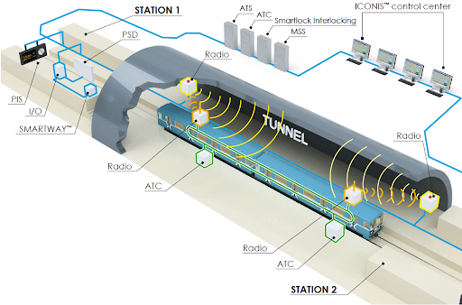
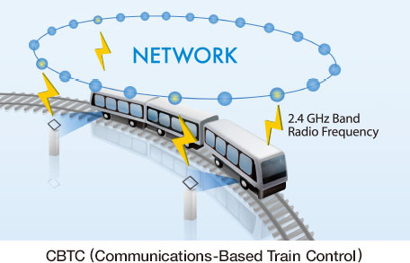
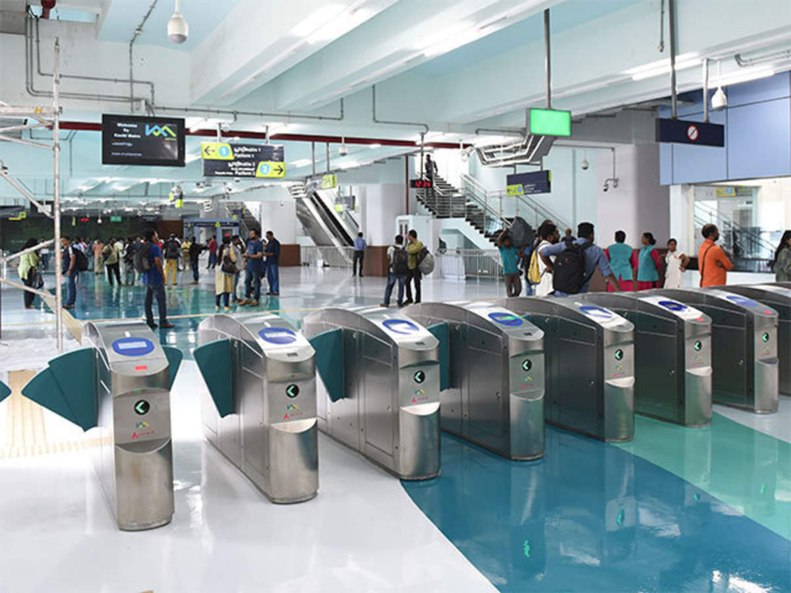
TECHNICAL ANALYSIS
Get a Train Signaling and Control Systems: -
The main design feature of signaling and train control shall be proven and advance system being used worldwide. It shall provide the highest security level for means of an effective train control ensuring strict safety in train movements. At the same time, it shall meet the requirements for efficient train operation and high quality service
Automatic Fare Collection System
Telecommunication System: -
Telecommunication facilities are helpful in meeting requirement of operations of trains.
Supplementing the Signaling system for efficient train operation. 2. Exchange of managerial information. 3. Crisis management during emergencies. 4. Passenger information system.
It acts as a communication back-bone for signaling system and other systems
To achieve objective of metro system, ticketing system should be simple, easy to use / operate and maintain, easy on accounting facility, capable of issuing single / multiple journey tickets, amendable for quick fare changes and require overall less manpower. In view of above computer based automatic fare collection is proposed.

Slide 11
LEGAL SYSTEM /
STANDARDS & LOCATION
Legal Policy
The Water (Prevention and Control of Pollution) Cess Act 1977, (Amendment), 2003
The Water (Prevention and Control of Pollution) Cess Rules, 1978, 1991.
The Air (Prevention and Control of Pollution) Act 1981, amended 1987. •
The Air (Prevention and Control of Pollution) (Union Territories) Rules, 1982, 1983
Noise Pollution (Regulation and Control) Rules, 2000 amendment 2002, 2006.
Municipal Solid Waste Rules, 2000
The Environment (Protection) Act, 1986, amended 1991.
The Environment (Protection) Rules,1986.
The Indian Forest Act, 1927.
Forest (Conservation) Act, 1980, amended 1988.
Forest (Conservation) Rules, 2003.
The Wild Life (Protection) Act 1972, Amendment, 2002

Slide 12
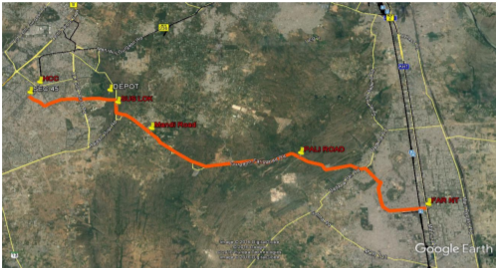

Slide 13

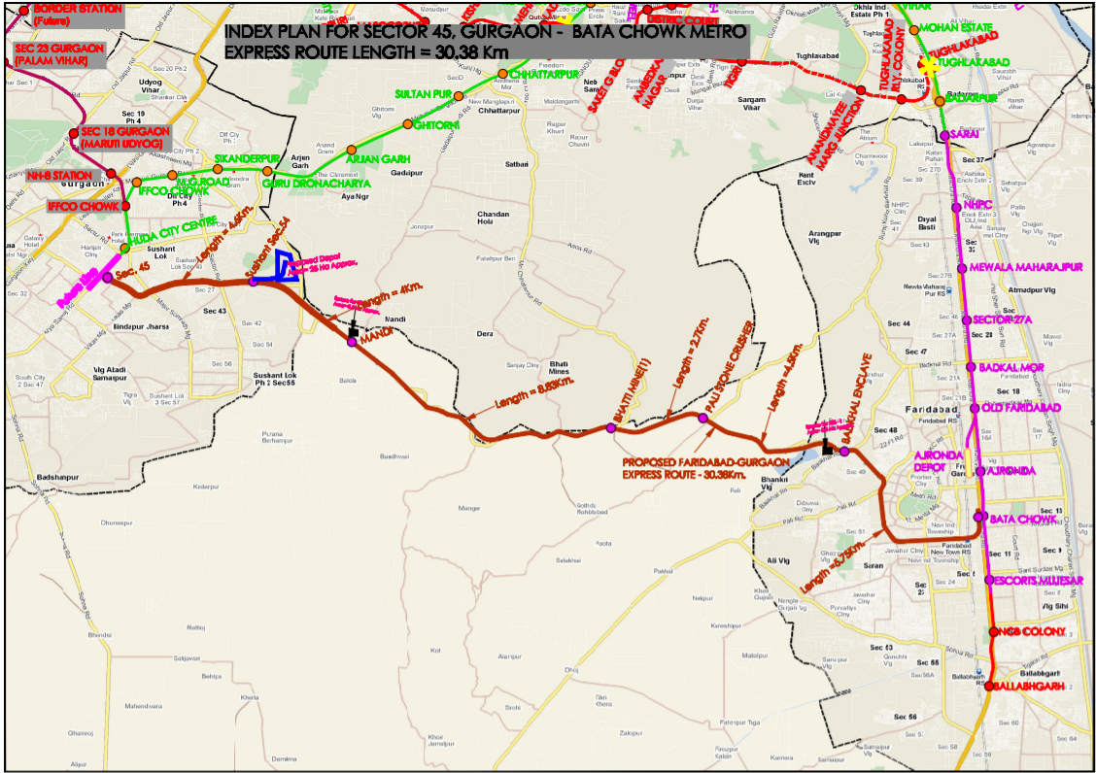

Slide 14
THANK YOU

